Slide 1


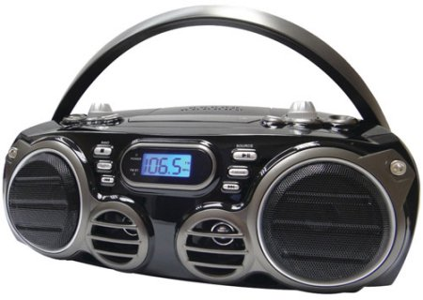
CS4102 Algorithms
Spring 2023
Movie Time!
In Season 9 Episode 7 “The Slicer” of the hit 90s TV show Seinfeld, George discovers that, years prior, he had a heated argument with his new boss, Mr. Kruger. This argument ended in George throwing Mr. Kruger’s boombox into the ocean. How did George make this discovery?
https://www.youtube.com/watch?v=pSB3HdmLcY4

Slide 2
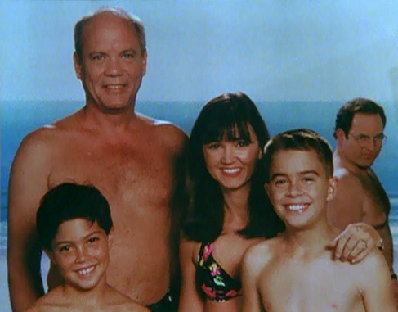

Slide 3
Seam Carving
Method for image resizing that doesn’t scale/crop the image

Slide 4
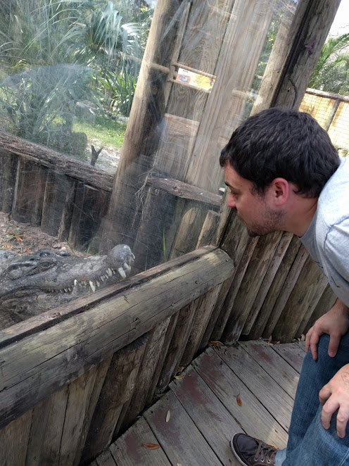
Seam Carving
Method for image resizing that doesn’t scale/crop the image

Slide 5
Seam Carving
Method for image resizing that doesn’t scale/crop the image

Slide 6
Seam Carving
Method for image resizing that doesn’t scale/crop the image
Cropped
Scaled
Carved

Slide 7
Cropping
Removes a “block” of pixels
Cropped

Slide 8
Scaling
Removes “stripes” of pixels
Scaled

Slide 9
Seam Carving
Removes “least energy seam” of pixels
https://trekhleb.dev/js-image-carver/
Carved

Slide 10
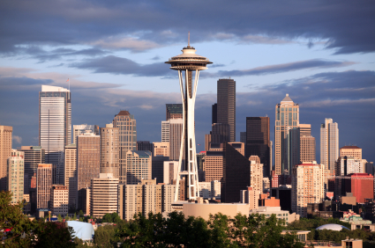
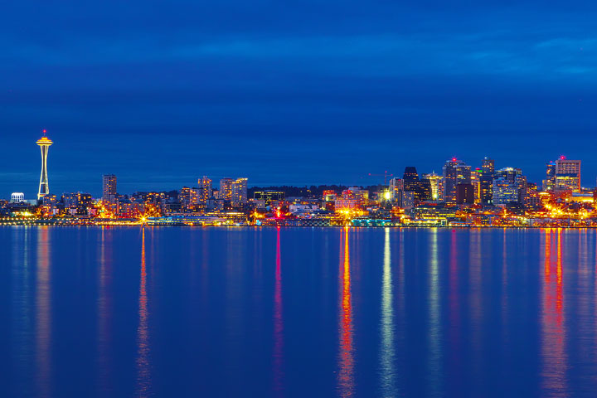
Seattle Skyline

Slide 11
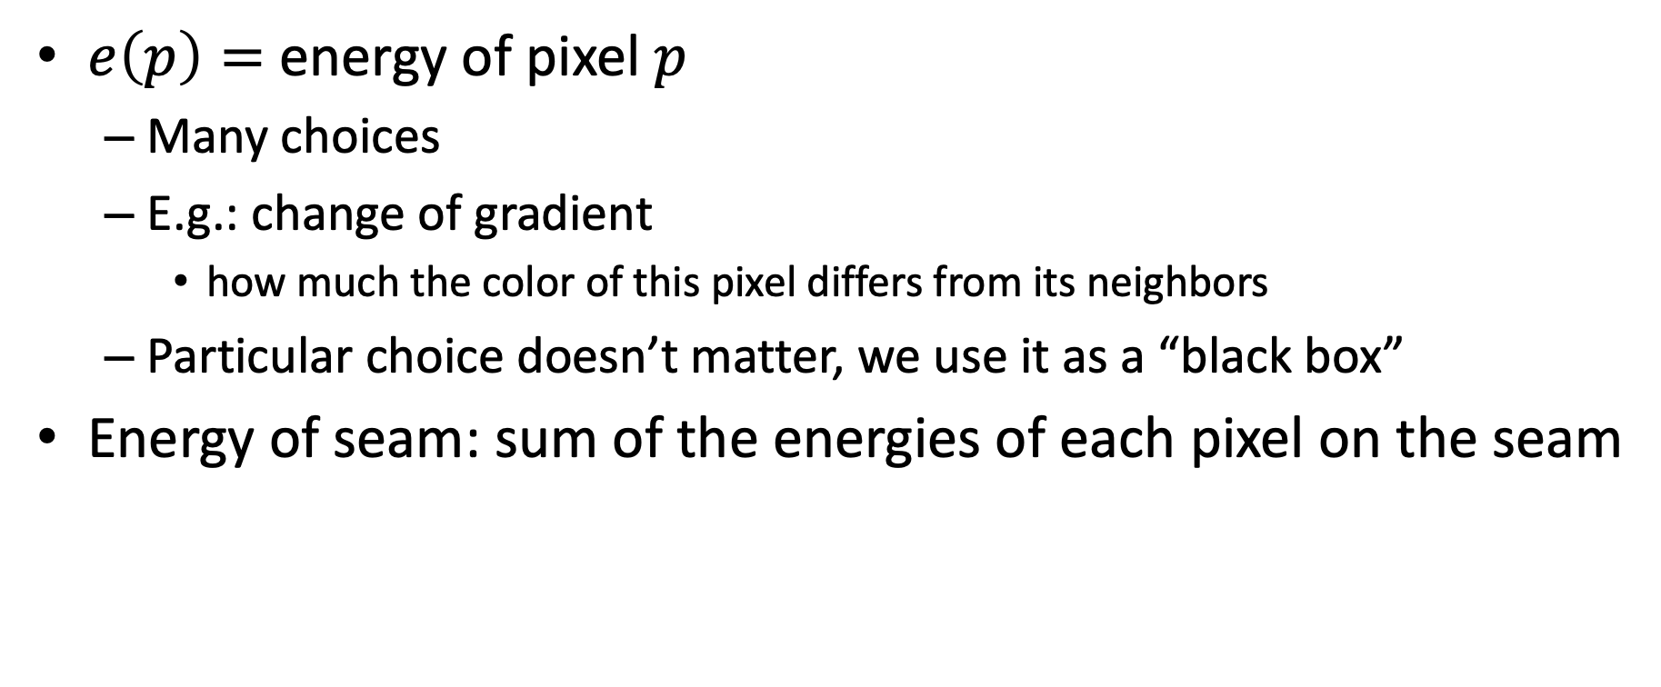
Energy of a Seam
$e\left(p\right)=$ energy of pixel $p$
Many choices
E.g.: change of gradient
how much the color of this pixel differs from its neighbors
Particular choice doesn’t matter, we use it as a “black box”
Energy of seam: sum of the energies of each pixel on the seam

Slide 12
Dynamic Programming
Requires Optimal Substructure
Solution to larger problem is the (optimal) solutions to a smaller one plus one “decision”
Idea:
Identify the substructure of the problem
What are the options for the “last thing” done? What subproblem comes from each?
Save the solution to each subproblem in memory
Select an order for solving subproblems
“Top Down”: Solve each recursively
“Bottom Up”: Iteratively solve smallest to largest

Slide 13
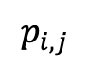
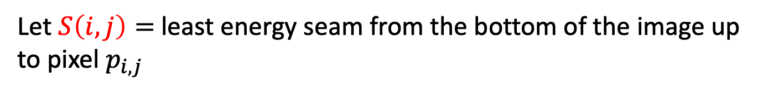
Identify Recursive Structure
Let $S\left(i,j\right)=$least energy seam from the bottom of the image up to pixel $p_{i,j}$
$$p_{i,j}$$

Slide 14
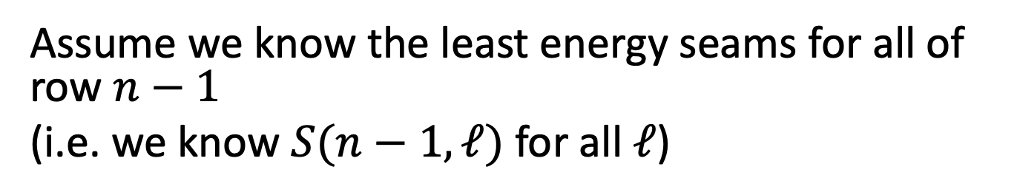

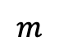
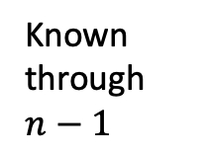
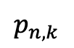
Computing $S(n,k)$
Assume we know the least energy seams for all of row $n−1$
(i.e. we know $S(n−1,ℓ)$ for all $ℓ$)
$$p_{n,k}$$
Known through $n−1$
$$m$$

Slide 15

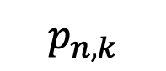
Computing $S(n,k)$
Assume we know the least energy seams for all of row $n−1$ (i.e. we know $S(n−1,ℓ)$ for all $ℓ$)
$$p_{n,k}$$
S(n,k)
S(n-1,k-1)
S(n-1,k)
S(n-1,k+1)

Slide 16
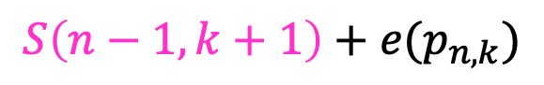
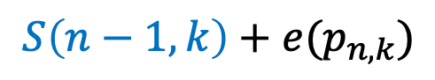
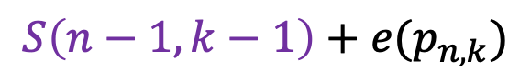
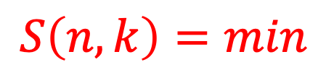
Computing $S(n,k)$
Assume we know the least energy seams for all of row $n−1$ (i.e. we know $S(n−1,ℓ)$ for all $ℓ$)
$$S\left(n−1,k−1\right)+e(p_{n,k})$$
$$S\left(n,k\right)=min$$
$$p_{n,k}$$
$$S\left(n−1,k\right)+e(p_{n,k})$$
S(n,k)
$$S\left(n−1,k+1\right)+e(p_{n,k})$$
S(n-1,k-1)
S(n-1,k)
S(n-1,k+1)

Slide 17

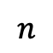
Finding the Least Energy Seam
Want the least energy seam going from bottom to top, so delete:
$$\underset{k=1}{\overset{m}{min}}\left(S(n,k)\right)$$
$$p_{n,k}$$
$$n$$
$$m$$

Slide 18
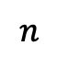
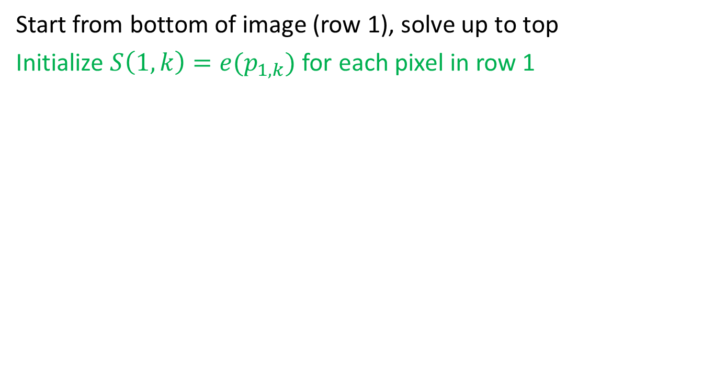
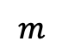
Bring It All Together
Start from bottom of image (row 1), solve up to top
Initialize $S\left(1,k\right)=e(p_{1,k})$ for each pixel in row 1
$$n$$
Energy of the seam initialized to the energy of that pixel
$$m$$

Slide 19
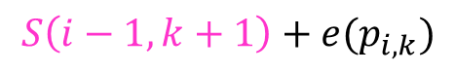
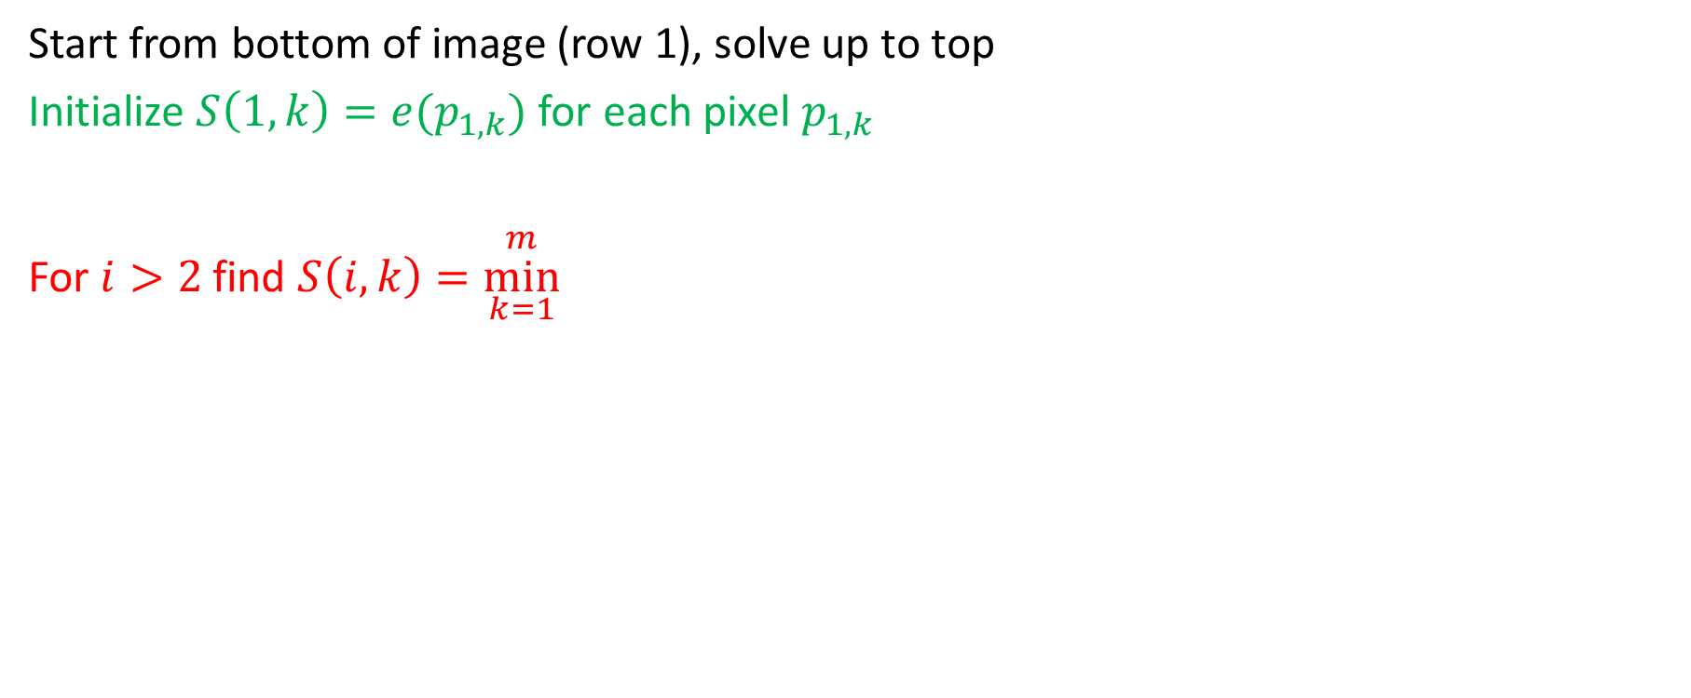
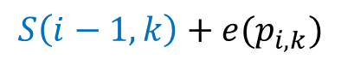
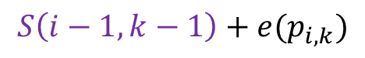
Bring It All Together
Start from bottom of image (row 1), solve up to top
Initialize $S\left(1,k\right)=e(p_{1,k})$ for each pixel $p_{1,k}$
For $i>2$ find $S\left(i,k\right)=\underset{k=1}{\overset{m}{min}}$
$$S\left(i−1,k−1\right)+e(p_{i,k})$$
$$S\left(i−1,k\right)+e(p_{i,k})$$
$$S\left(i−1,k+1\right)+e(p_{i,k})$$
$$n$$
Energy of the seam initialized to the energy of that pixel
$$m$$

Slide 20
Top Down Least Energy Seam Pseudocode

Slide 21
Top Down Least Energy Seam Pseudocode
Initialize Memory C as an n-by-m array of -1s
def S(i,j):
if C[i][j] > -1:
return C[i][j]
if i == 1:
C[i][j] = e(i,j)
return e(i,j)
best = infty
best = min(best, S(i-1, j-1) + e(i,j))
best = min(best, S(i-1, j) + e(i,j))
best = min(best, S(i-1, j+1) + e(i,j))
C[i][j] = best
return best

Slide 22
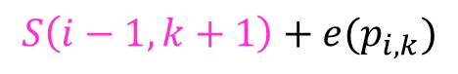
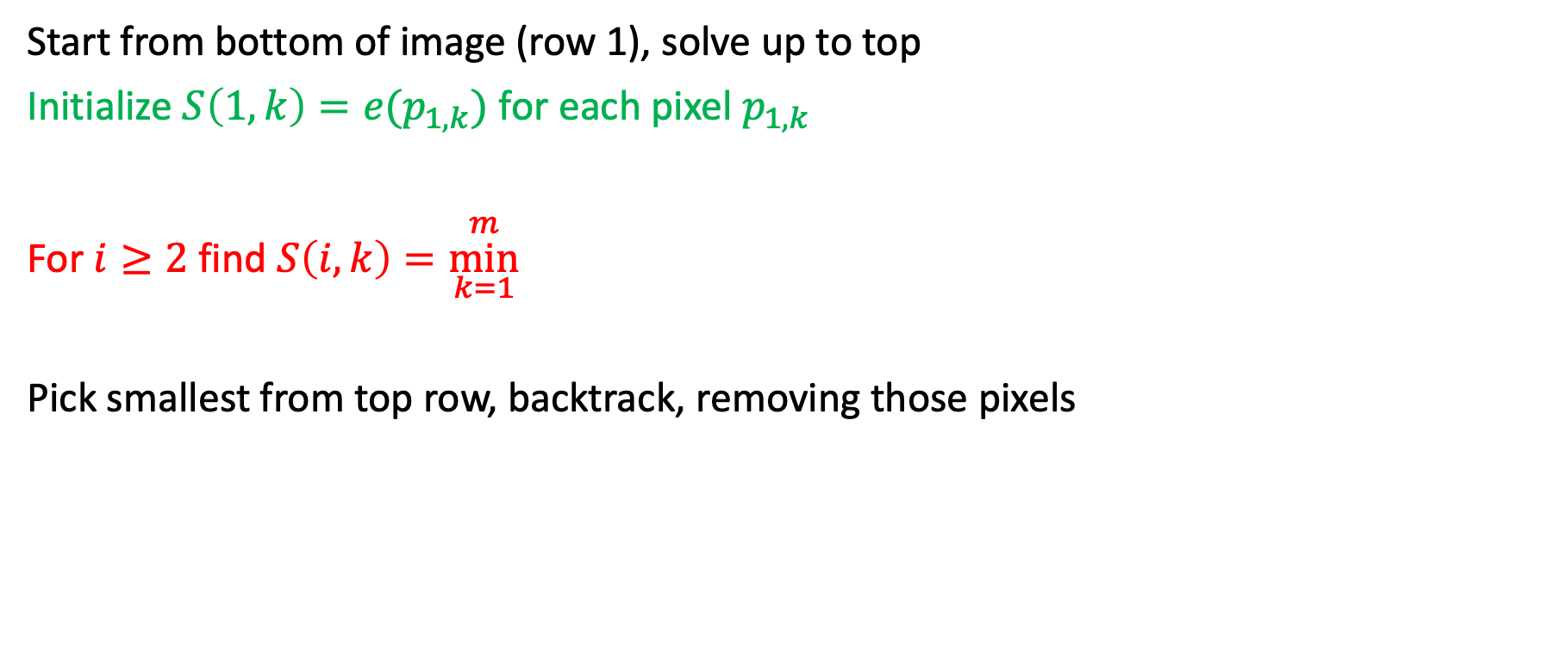
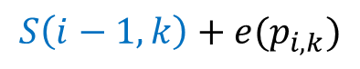
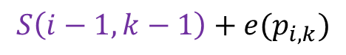
Bring It All Together
Start from bottom of image (row 1), solve up to top
Initialize $S\left(1,k\right)=e(p_{1,k})$ for each pixel $p_{1,k}$
For $i≥2$ find $S\left(i,k\right)=\underset{k=1}{\overset{m}{min}}$
Pick smallest from top row, backtrack, removing those pixels
$$S\left(i−1,k−1\right)+e(p_{i,k})$$
$$S\left(i−1,k\right)+e(p_{i,k})$$
$$S\left(i−1,k+1\right)+e(p_{i,k})$$
$$n$$
Energy of the seam initialized to the energy of that pixel
$$m$$

Slide 23
Seam Carving Pseudocode

Slide 24
Seam Carving Pseudocode
def remove_seam(picture):
seams = []
for i in range(picture.width):
seams.append(S(i,picture.height))
min_seam_end = min_index(seams)
min_seam = backtrack(min_seam_end)
picture.remove(min_seam)

Slide 25
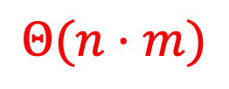
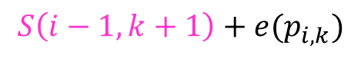

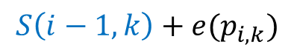
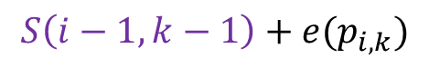
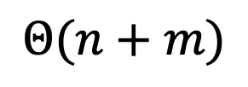
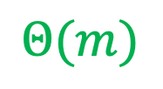
Run Time?
Start from bottom of image (row 1), solve up to top
Initialize $S\left(1,k\right)=e(p_{1,k})$ for each pixel $p_{1,k}$
For $i≥2$ find $S\left(i,k\right)=\underset{k=1}{\overset{m}{min}}$
Pick smallest from top row, backtrack, removing those pixels
$$Θ(m)$$
$$S\left(i−1,k−1\right)+e(p_{i,k})$$
$$Θ(n⋅m)$$
$$S\left(i−1,k\right)+e(p_{i,k})$$
$$S\left(i−1,k+1\right)+e(p_{i,k})$$
$$Θ(n+m)$$
$$n$$
Energy of the seam initialized to the energy of that pixel
$$m$$

Slide 26
Seam Carving Bottom Up

Slide 27
Seam Carving Bottom Up
for I in range(picture.width):
S[i][0] = e(i,j)
for j in range(1:picture.width):
for i in range(picture.width):
#edge case watch out
best = infty
best = min(best, S(i-1, j-1) + e(i,j))
best = min(best, S(i-1, j) + e(i,j))
best = min(best, S(i-1, j+1) + e(i,j))
S[i][j] = best
min_seam_end = min_index(S[picture.height])
min_seam = backtrack(min_seam_end)
picture.remove(min_seam)

Slide 28

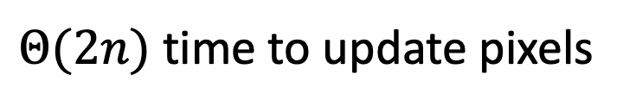

Repeated Seam Removal
Only need to update pixels dependent on the removed seam
$2n$ pixels change
$Θ(2n)$ time to update pixels
$Θ(n+m)$ time to find min+backtrack
$$n$$
$$m$$

Slide 29

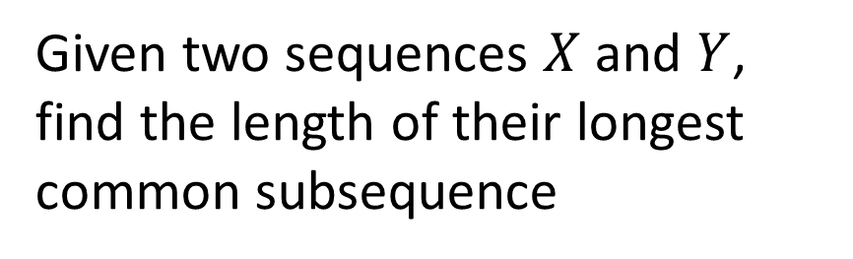
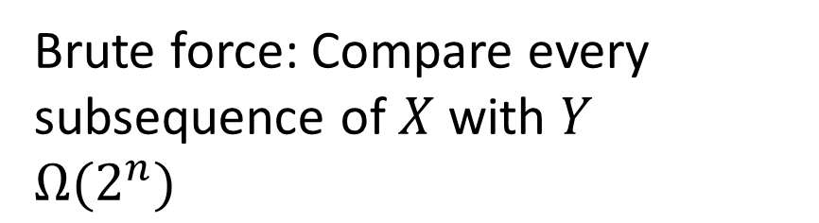
Longest Common Subsequence
Given two sequences $X$ and $Y$, find the length of their longest common subsequence
Example:
𝑋 = 𝐴𝑇𝐶𝑇𝐺𝐴𝑇
𝑌 = 𝑇𝐺𝐶𝐴𝑇𝐴
𝐿𝐶𝑆 = 𝑇𝐶𝑇𝐴
Brute force: Compare every subsequence of $X$ with $Y$
$Ω(2^{n})$

Slide 30
Dynamic Programming
Requires Optimal Substructure
Solution to larger problem is the (optimal) solutions to a smaller one plus one “decision”
Idea:
Identify the substructure of the problem
What are the options for the “last thing” done? What subproblem comes from each?
Save the solution to each subproblem in memory
Select an order for solving subproblems
“Top Down”: Solve each recursively
“Bottom Up”: Iteratively solve smallest to largest

Slide 31

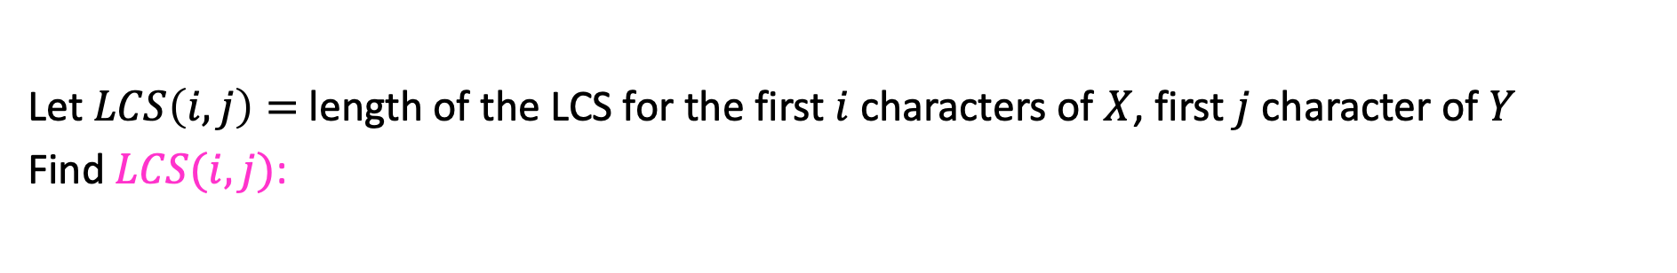

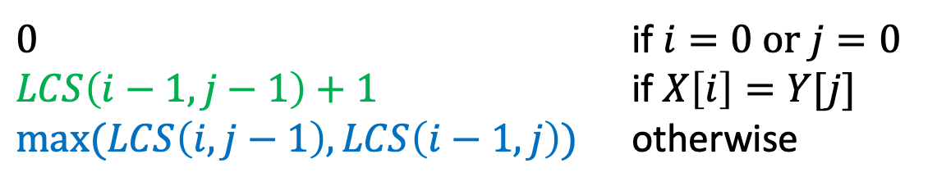
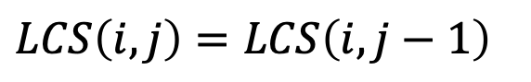
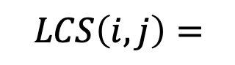
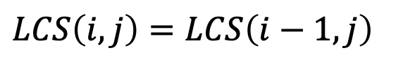

1. Identify Recursive Structure
Let $LCS\left(i,j\right)=$ length of the LCS for the first $i$ characters of $X$, first $j$ character of $Y$
Find $LCS(i,j)$:
Case 1: $X\left[i\right]=Y[j]$
X = ATCTGCGT
Y = TGCATAT
$$LCS\left(i,j\right)=LCS\left(i−1, j−1\right)+1$$
Case 2: $X\left[i\right]≠Y[j]$
X=ATCTGCGA
Y=TGCATAT
X=ATCTGCGT
Y=TGCATAC
$LCS\left(i,j\right)=LCS\left(i,j−1\right)$
$LCS\left(i,j\right)=LCS\left(i−1,j\right)$
$0$ if $i=0$ or $j=0$
$LCS\left(i−1,j−1\right)+1$ if $X\left[i\right]=Y[j]$
$\max{(LCS\left(i,j−1\right),LCS\left(i−1,j\right))}$ otherwise
$$LCS\left(i,j\right)=$$

Slide 32
Dynamic Programming
Requires Optimal Substructure
Solution to larger problem is the (optimal) solutions to a smaller one plus one “decision”
Idea:
Identify the substructure of the problem
What are the options for the “last thing” done? What subproblem comes from each?
Save the solution to each subproblem in memory
Select an order for solving subproblems
“Top Down”: Solve each recursively
“Bottom Up”: Iteratively solve smallest to largest

Slide 33

1. Identify Recursive Structure
Let $LCS\left(i,j\right)=$ length of the LCS for the first $i$ characters of $X$, first $j$ character of $Y$
Find $LCS(i,j)$:
Case 1: $X\left[i\right]=Y[j]$
X = ATCTGCGT
Y = TGCATAT
$$LCS\left(i,j\right)=LCS\left(i−1, j−1\right)+1$$
Case 2: $X\left[i\right]≠Y[j]$
X=ATCTGCGA
Y=TGCATAT
X=ATCTGCGT
Y=TGCATAC
$LCS\left(i,j\right)=LCS\left(i,j−1\right)$
$LCS\left(i,j\right)=LCS\left(i−1,j\right)$
Read from M[i,j]
if present
$0$ if $i=0$ or $j=0$
$LCS\left(i−1,j−1\right)+1$ if $X\left[i\right]=Y[j]$
$\max{(LCS\left(i,j−1\right),LCS\left(i−1,j\right))}$ otherwise
$$LCS\left(i,j\right)=$$
Save to M[i,j]

Slide 34

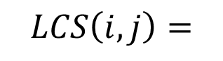
X = “alkjdflaksjdf”
Y = “lakjsdflkasjdlfs”
M = 2d array of len(X) rows and len(Y) columns, initialized to -1
def LCS(int i, int j):
# returns the length of the LCS shared between the length-i prefix of X and length-j prefix of Y
# memoization
if M[i,j] > -1:
return M[i,j]
#base case:
if i == 0 or j == 0:
ans = 0
elif X[i] == Y[j]:
ans = LCS(i-1, j-1) + 1
else:
ans = max( LCS(i, j-1), LCS(i-1, j) )
M[i,j] = ans
return ans
print(LCS(len(X)+1, len(Y)+1)) # the answer for the entirety of X and Y
$0$ if $i=0$ or $j=0$
$LCS\left(i−1,j−1\right)+1$ if $X\left[i\right]=Y[j]$
$\max{(LCS\left(i,j−1\right),LCS\left(i−1,j\right))}$ otherwise
$$LCS\left(i,j\right)=$$

Slide 35
Dynamic Programming
Requires Optimal Substructure
Solution to larger problem is the (optimal) solutions to a smaller one plus one “decision”
Idea:
Identify the substructure of the problem
What are the options for the “last thing” done? What subproblem comes from each?
Save the solution to each subproblem in memory
Select an order for solving subproblems
“Top Down”: Solve each recursively
“Bottom Up”: Iteratively solve smallest to largest

Slide 36





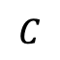





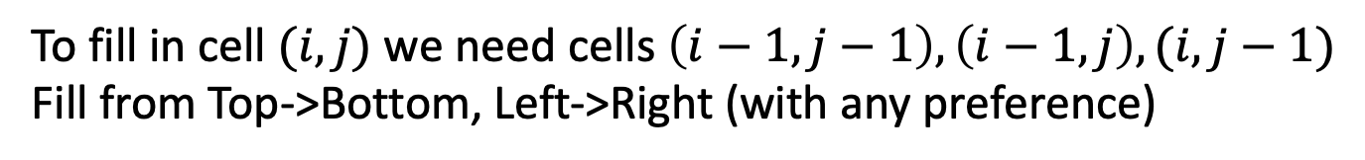






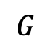


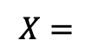
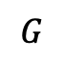



3. Solve in a Good Order
$0$ if $i=0$ or $j=0$
$LCS\left(i−1,j−1\right)+1$ if $X\left[i\right]=Y[j]$
$\max{(LCS\left(i,j−1\right),LCS\left(i−1,j\right))}$ otherwise
$$LCS\left(i,j\right)=$$
$$X=$$
$$A$$
$$T$$
$$C$$
$$T$$
$$G$$
$$A$$
$$T$$
$$Y=$$
$$0$$
$$1$$
$$2$$
$$3$$
$$4$$
$$5$$
$$6$$
$$7$$
$$0$$
0 | 0 | 0 | 0 | 0 | 0 | 0 | 0
0 | 0 | 1 | 1 | 1 | 1 | 1 | 1
0 | 0 | 1 | 1 | 1 | 2 | 2 | 2
0 | 0 | 1 | 2 | 2 | 2 | 2 | 2
0 | 1 | 1 | 2 | 2 | 2 | 3 | 3
0 | 1 | 2 | 2 | 3 | 3 | 3 | 4
0 | 1 | 2 | 2 | 3 | 3 | 4 | 4
$$T$$
$$1$$
$$G$$
$$2$$
$$C$$
$$3$$
$$A$$
$$4$$
$$T$$
$$5$$
$$A$$
$$6$$
To fill in cell $(i,j)$ we need cells $\left(i−1,j−1\right),\left(i−1,j\right),(i,j−1)$
Fill from Top->Bottom, Left->Right (with any preference)

Slide 37
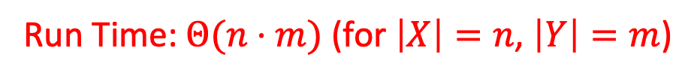
Run Time?
$0$ if $i=0$ or $j=0$
$LCS\left(i−1,j−1\right)+1$ if $X\left[i\right]=Y[j]$
$\max{(LCS\left(i,j−1\right),LCS\left(i−1,j\right))}$ otherwise
$$LCS\left(i,j\right)=$$
$$X=$$
$$A$$
$$T$$
$$C$$
$$T$$
$$G$$
$$A$$
$$T$$
$$Y=$$
$$0$$
$$1$$
$$2$$
$$3$$
$$4$$
$$5$$
$$6$$
$$7$$
$$0$$
0 | 0 | 0 | 0 | 0 | 0 | 0 | 0
0 | 0 | 1 | 1 | 1 | 1 | 1 | 1
0 | 0 | 1 | 1 | 1 | 2 | 2 | 2
0 | 0 | 1 | 2 | 2 | 2 | 2 | 2
0 | 1 | 1 | 2 | 2 | 2 | 3 | 3
0 | 1 | 2 | 2 | 3 | 3 | 3 | 4
0 | 1 | 2 | 2 | 3 | 3 | 4 | 4
$$T$$
$$1$$
$$G$$
$$2$$
$$C$$
$$3$$
$$A$$
$$4$$
$$T$$
$$5$$
$$A$$
$$6$$
Run Time: $Θ(n⋅m)$ (for $\left|X\right|=n$, $\left|Y\right|=m$)

Slide 38
Reconstructing the LCS
$0$ if $i=0$ or $j=0$
$LCS\left(i−1,j−1\right)+1$ if $X\left[i\right]=Y[j]$
$\max{(LCS\left(i,j−1\right),LCS\left(i−1,j\right))}$ otherwise
$$LCS\left(i,j\right)=$$
$$X=$$
$$A$$
$$T$$
$$C$$
$$T$$
$$G$$
$$A$$
$$T$$
$$Y=$$
$$0$$
$$1$$
$$2$$
$$3$$
$$4$$
$$5$$
$$6$$
$$7$$
$$0$$
0 | 0 | 0 | 0 | 0 | 0 | 0 | 0
0 | 0 | 1 | 1 | 1 | 1 | 1 | 1
0 | 0 | 1 | 1 | 1 | 2 | 2 | 2
0 | 0 | 1 | 2 | 2 | 2 | 2 | 2
0 | 1 | 1 | 2 | 2 | 2 | 3 | 3
0 | 1 | 2 | 2 | 3 | 3 | 3 | 4
0 | 1 | 2 | 2 | 3 | 3 | 4 | 4
$$T$$
$$1$$
$$G$$
$$2$$
$$C$$
$$3$$
$$A$$
$$4$$
$$T$$
$$5$$
$$A$$
$$6$$
Start from bottom right,
if symbols matched, print that symbol then go diagonally
else go to largest adjacent

Slide 39
Reconstructing the LCS
$0$ if $i=0$ or $j=0$
$LCS\left(i−1,j−1\right)+1$ if $X\left[i\right]=Y[j]$
$\max{(LCS\left(i,j−1\right),LCS\left(i−1,j\right))}$ otherwise
$$LCS\left(i,j\right)=$$
$$X=$$
$$A$$
$$T$$
$$C$$
$$T$$
$$G$$
$$A$$
$$T$$
$$Y=$$
$$0$$
$$1$$
$$2$$
$$3$$
$$4$$
$$5$$
$$6$$
$$7$$
$$0$$
0 | 0 | 0 | 0 | 0 | 0 | 0 | 0
0 | 0 | 1 | 1 | 1 | 1 | 1 | 1
0 | 0 | 1 | 1 | 1 | 2 | 2 | 2
0 | 0 | 1 | 2 | 2 | 2 | 2 | 2
0 | 1 | 1 | 2 | 2 | 2 | 3 | 3
0 | 1 | 2 | 2 | 3 | 3 | 3 | 4
0 | 1 | 2 | 2 | 3 | 3 | 4 | 4
$$T$$
$$1$$
$$G$$
$$2$$
$$C$$
$$3$$
$$A$$
$$4$$
$$T$$
$$5$$
$$A$$
$$6$$
Start from bottom right,
if symbols matched, print that symbol then go diagonally
else go to largest adjacent

Slide 40
Reconstructing the LCS
$0$ if $i=0$ or $j=0$
$LCS\left(i−1,j−1\right)+1$ if $X\left[i\right]=Y[j]$
$\max{(LCS\left(i,j−1\right),LCS\left(i−1,j\right))}$ otherwise
$$LCS\left(i,j\right)=$$
$$X=$$
$$A$$
$$T$$
$$C$$
$$T$$
$$G$$
$$A$$
$$T$$
$$Y=$$
$$0$$
$$1$$
$$2$$
$$3$$
$$4$$
$$5$$
$$6$$
$$7$$
$$0$$
0 | 0 | 0 | 0 | 0 | 0 | 0 | 0
0 | 0 | 1 | 1 | 1 | 1 | 1 | 1
0 | 0 | 1 | 1 | 1 | 2 | 2 | 2
0 | 0 | 1 | 2 | 2 | 2 | 2 | 2
0 | 1 | 1 | 2 | 2 | 2 | 3 | 3
0 | 1 | 2 | 2 | 3 | 3 | 3 | 4
0 | 1 | 2 | 2 | 3 | 3 | 4 | 4
$$T$$
$$1$$
$$G$$
$$2$$
$$C$$
$$3$$
$$A$$
$$4$$
$$T$$
$$5$$
$$A$$
$$6$$
Start from bottom right,
if symbols matched, print that symbol then go diagonally
else go to largest adjacent

